Slide 1



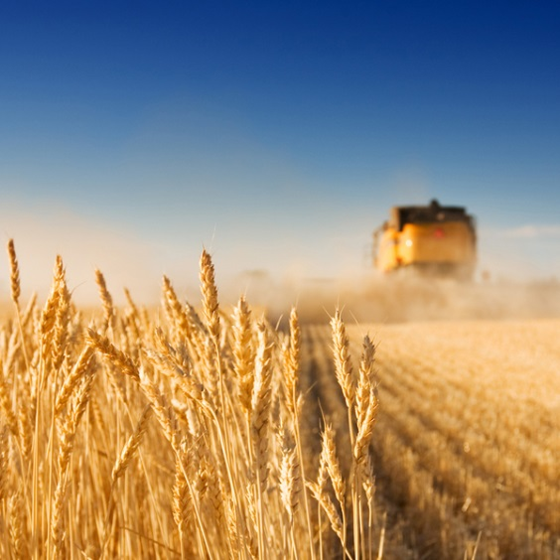
The Protein Application Ontology (P-PRO)
Hannelore Heuer,
Research group: Food Informatics
Research Institute: Wageningen Food and Biobased Research
Aug 15, 2022
Notes:
Introduction
Hello and welcome everyone!
I am Hannelore Heuer, researcher at the Wageningen Food and Biobased Research Institute.
As the name of our institute suggests, we perform applied research for sustainable innovations in healthy food, fresh food chains and biobased products.
We, as the Food Informatics group, digitalize the knowledge of those groups and facilitate sharing and linking research output.
Currently the world is facing a large population growth, which poses challenges regarding food security.
One of the research themes for all of Wageningen University and Research is ‘Proteins for life’.
Hence, this requires domain experts, governmental organisations, policy makers, you name it, to communicate about proteins.

Slide 2
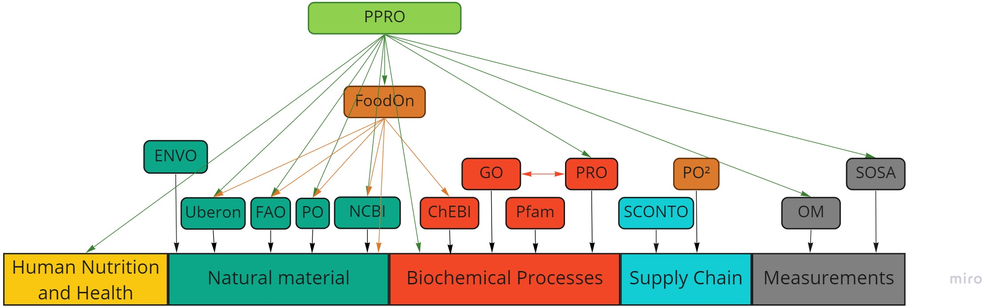
Proteins and their application
PPRO: Investigating the interoperability of data regarding proteins in their interaction with the world
What exists already?
Additions: protein technology, digestibility information, sensory information
Notes:
From this, the need for a Protein Application Ontology arose.
We named it ‘P-PRO’ and use it to enable data sharing between all different parties involved in protein research and application.
Now you must be asking yourself ‘ontologies that focus on the structure of proteins and their biochemical processes already exist such as PRO and GO, and we have FoodOn, what do we need another protein ontology for?’
Well, these ontologies do not really focus on all parts of the application of proteins in the industry, and therefore they are not complete to annotate or link all existing data about proteins.
They do not always provide the right level of communication about proteins between different disciplines.
We have worked on a complementary ontology that can be used by various disciplines and for different purposes such as data annotation and data linking.
PPRO in the web of other ontologies
We made this overview according to the already existing ontologies out there, similar to the FoodOn overview.
Our ontology links to anatomy and taxonomy ontologies, measurement ontologies and to PRO. It also includes expert information about Protein Technology and Human Nutrition and Health.
Researchers from Protein Technology measure protein functionality on specific samples.
A big part of the research into Human Nutrition and Health regards digestibility and digestibility measures, and sensory assessments of food.
From expert interviews, we drafted the first version of the ontology.
We are currently in the process of validating the ontology by interviews with domain experts in the protein industry.
Additionally, we are working on automatic extraction of protein digestibility information from scientific publications.
The extracted terms will then be added to P-PRO to extend it further.

Slide 3
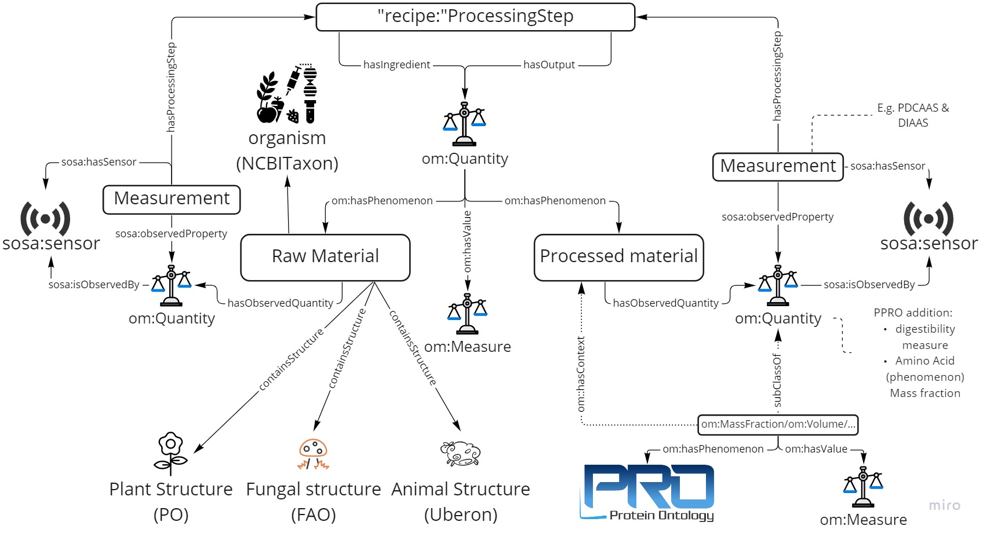

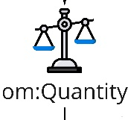
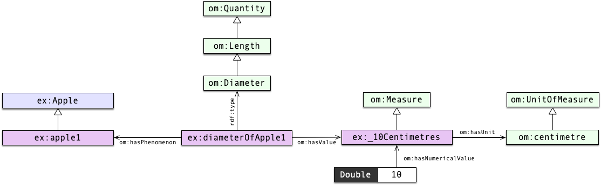
P-PRO structure
See https://github.com/HajoRijgersberg/OM
Notes:
PPRO structure
When we zoom in into the structure of P-PRO, we see that the main concept is the processed material.
A processed material corresponds to a protein containing food substance that has undergone at least one processing step.
The processed material can have a brand and a sample id.
This processed material can only occur in a certain quantity when things about it are measured or if it is used as an ingredient for processing and thus we have connected it to the om:Quantity concept in two ways.
OM side step
If we look at this concept, it has the prefix ‘om’, which refers to the Ontology of Units of Measures, which is one the most comprehensive ontologies to express quantities and units.
I have got this example of the diameter of an apple to demonstrate the structure of OM’s Quantity class.
The diameter of the apple is a quantity, it has a measured value of 10 centimetres, which has a unit in centimetres and a numerical value of 10.
The diameter occurs in the phenomenon of apple.
OM is based on several official paper standards, such as: The Guide for the Use of the International System of Units, by the National Institute of Standards and Technology.
PPRO structure
When we go back to our P-PRO ontology, the raw material contrasts with the processed material, as it is an ingredient for a processing step that will be a potential food product. It is not yet processed and is not composed of more than one organism.
This raw material, just like in FoodOn, comes from a NCBI Taxon species which can be further specified with their own variety or cultivar, and contains (some part of) a plant, fungus or animal.
These materials can be used as an ingredient for a processingStep, or they can be the output of a processingStep. Processing steps use a specific method, one or more ingredients and additives, a duration, concentration, equipment, pH, temperature, material used, and, last but not least, one or more outputs.
The raw and processed material can have many observed quantities, which are defined as OM quantities, such as solubility, viscosity, etc.
Since it is important to keep track of how these quantities are measured, a measurement concept was added and linked to OM.
The observed quantities also include concepts about digestibility, such as the Protein Digestibility Corrected Amino Acid Score (PDCAAS) and Digestible Indispensable Amino Acid Score (DIAAS). ​
Moreover, the quantities include a sensory intensity, which combines a specific sensory category, such as ‘bland’, ‘burnt’, ‘cheesy’, with a score for each of these categories. ​

Slide 4




Thank you for your attention!
Questions? Feel free to contact us
Food Informatics
Hannelore Heuer
Food and Data Science Researcher
T: +31 317 488 770 E: hannelore.heuer@wur.nl
Sander van Leeuwen Food and Data Science Researcher
T: +31 317 488458 E: sander.vanleeuwen@wur.nl
Hannelore Heuer
Sander van Leeuwen
Jan Top
Jan Top
Senior Researcher
T: +31 317 480212 E: jan.top@wur.nl
Acknowledgements funding:
Notes:
Conclusion
In this short presentation I have given you a quick overview of the structure of our Protein Application ontology and how it uses and relates to other ontologies.
This ontology is still a work in progress.
PPRO will be available as an open source ontology.
We want this ontology to be adopted widely so it can be added to or adapted by the standards already established.
Are there any questions?

